Slide 1


Data Science Portugal
#30
Everyday life AI: from the Interview Room to the Operating Room
May 14th, 2018 - Porto

Slide 2






Where are we?
/datascienceportugal
~ 1101
~ 512
/groups/datascienceportugal
/datascienceportugal
~ 777
/groups/8586496
~ 486
@datascience_pt
~ 375
/DataSciencePortugal
datascienceportugal.slack.com
datascienceportugal.herokuapp.com
Notes:
The platforms where you can interact with us
Register on Slack for interactive communication
TODO: conformar estes numeros

Slide 3
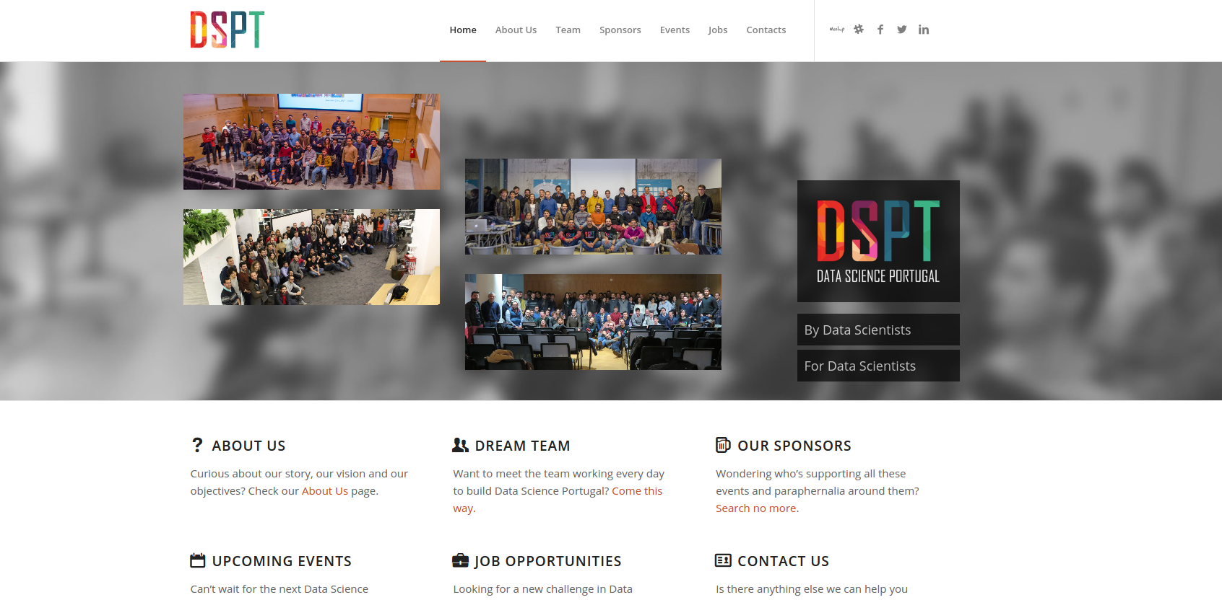
https://www.datascienceportugal.com
Notes:
Falar da Secção de Jobs e Eventos para ser colaborativo

Slide 4
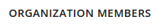
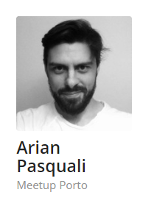
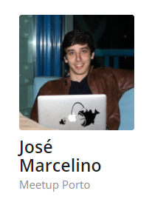
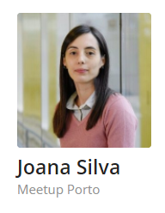
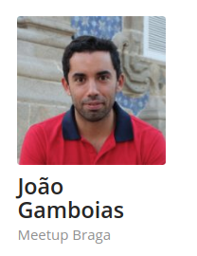
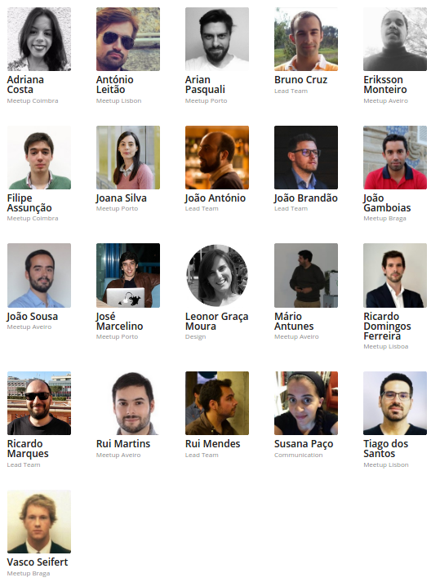
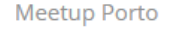
Team

Slide 5






















info@datascienceportugal.com
Notes:
We’re independent but need help to continue our activities
Sponsor and support from external entities and companies
These are the entities that help us with coffee break sponsoring, space for meetups or both
If you’re interested, contact us at info@datascienceportugal.com
Soon we’ll launch a plan for long term partnership with DSPT (rather than pontual help)
TODO: include novabase?

Slide 6
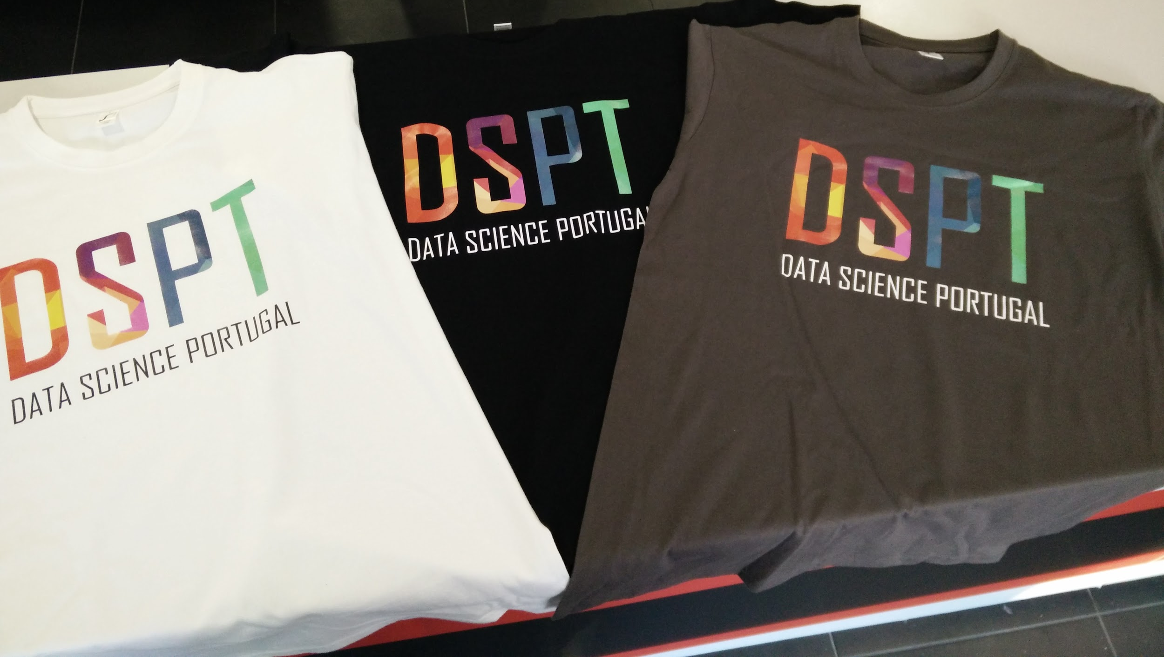
Your DSPT T-Shirt
Ordered a t-shirt? Be sure to get it from the staff!
Did you miss the call? Stay tuned
Notes:
Perguntar se há alguem no publico que encomendou t-shirts, falar com o rui.
Foi feito uma call, e será novamente brevemente.

Slide 7

DSPT Events
#1 DSPT Day
One day conference
2nd semester 2018 @ Porto
DSPT Day 2018
Notes:
TODO: colocar info sobre o speaker?

Slide 8
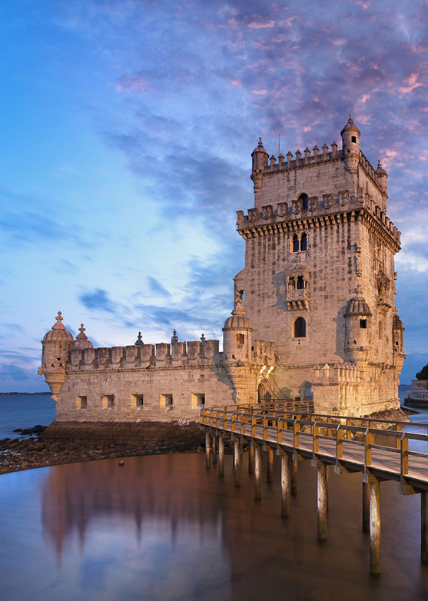
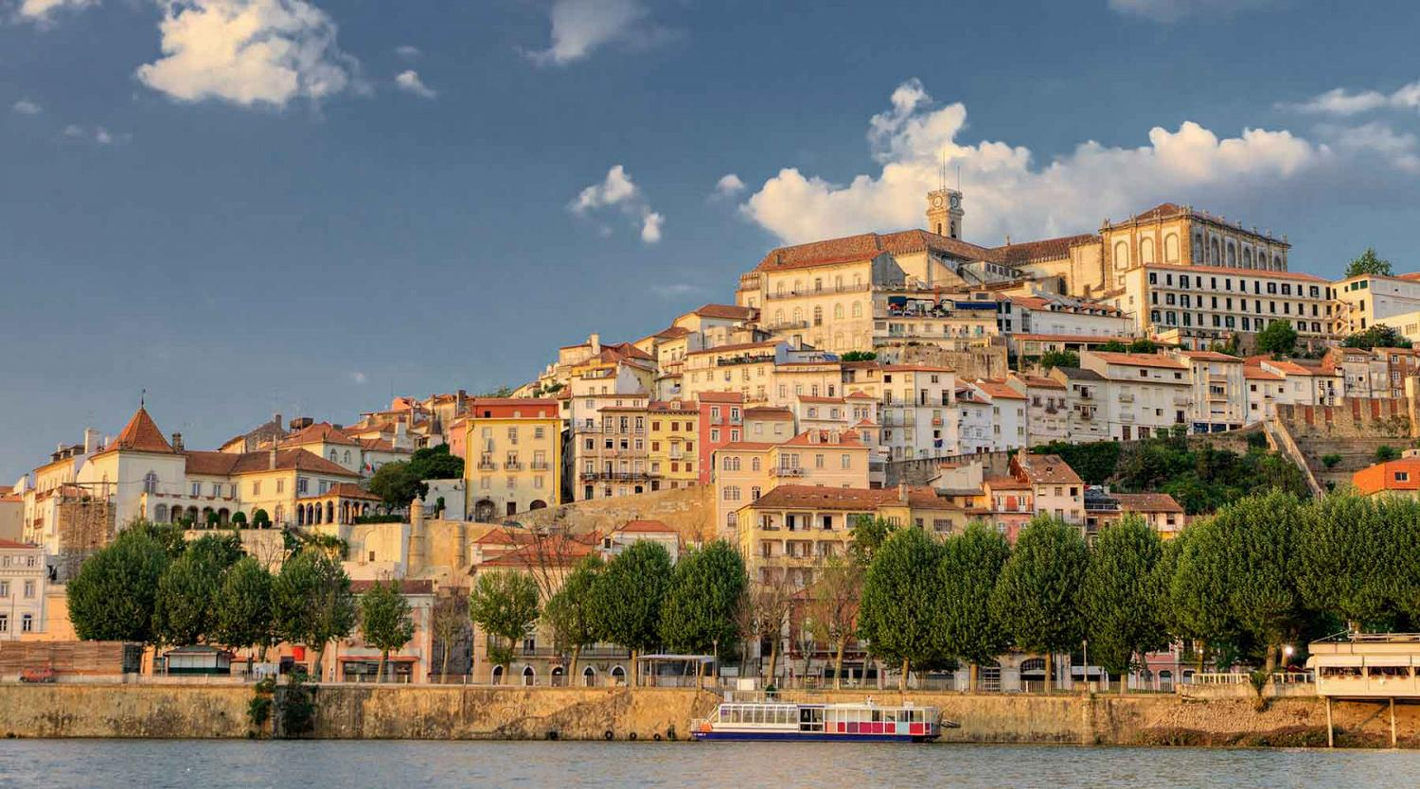
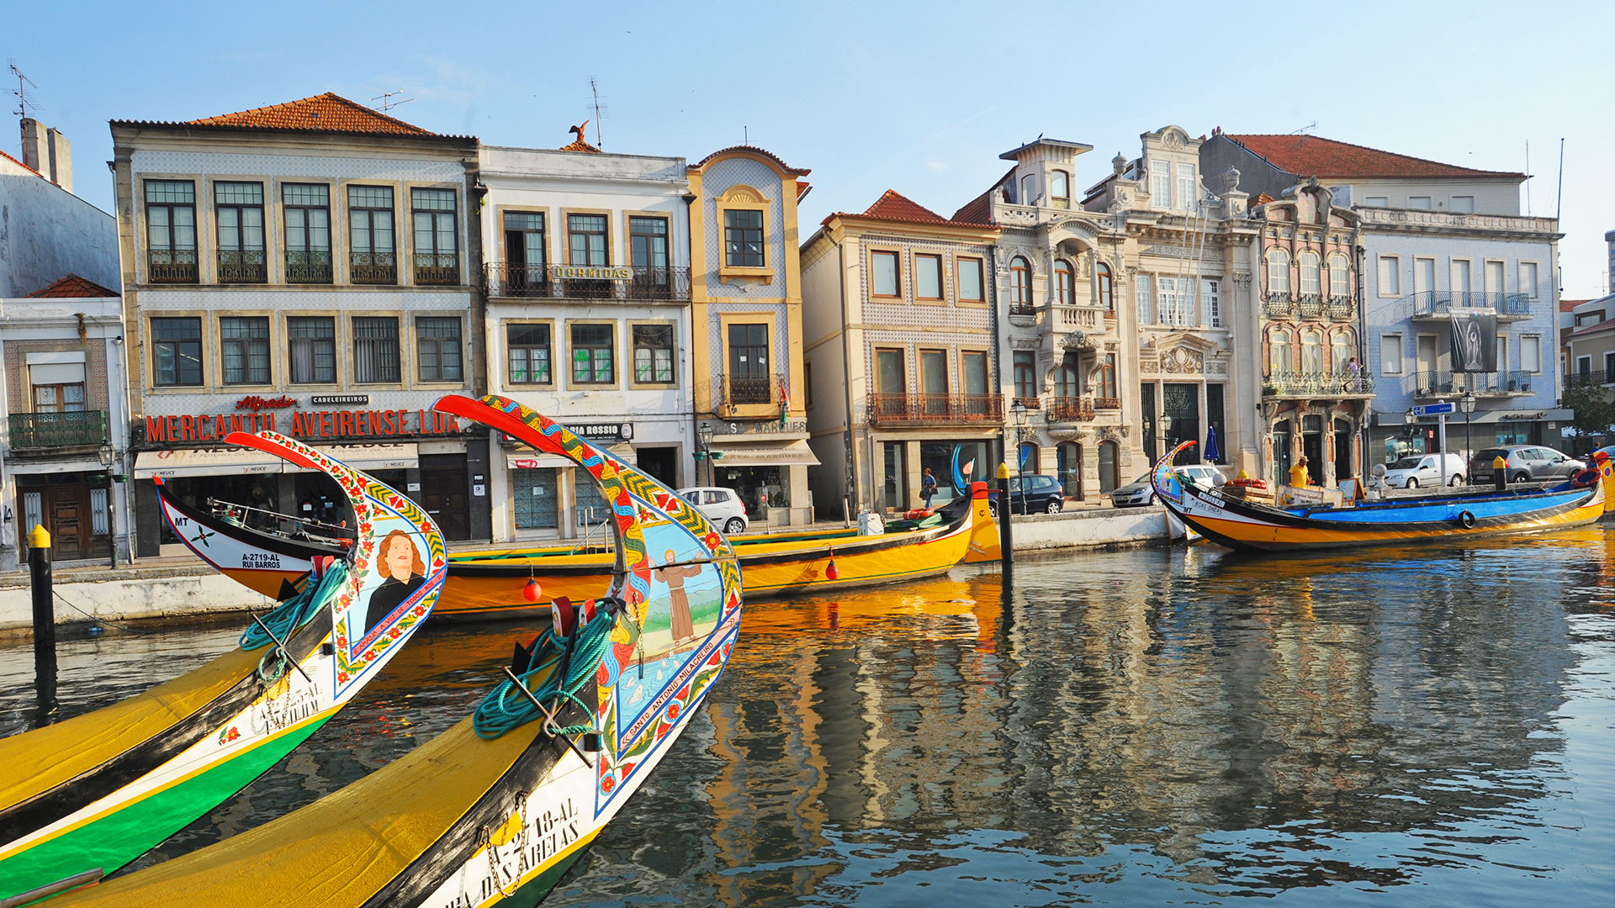
Next Scheduled Meetups
AVEIRO
AVEIRO
PORTO
LISBOA
COIMBRA
LISBOA
LISBOA
Notes:
Braga - April 17th - meetup #27
Porto - April 24th - meetup #28
Aveiro - April 27th - meetup #29
Lisboa - May 2th - May 4th - meetup #30

Slide 9

DSPT#30 is supported by:
Notes:
Sponsor(s): DevScope, Natixis

Slide 10
Agenda
18:30 - 19:15 | Welcome and get together
19:15 - 19:45 | Talk 1: "Machine Learning for Job Recommendations" by Katja Niemann - XING
19:55 - 20:00 | Group Photo
20:00 - 20:15 | Networking / Beer Break
20:15 - 20:45 | Talk 2: "Deep Patient: Leveraging Electronic Health Records Data to Predict Patient Outcomes" by Tiago Vinhoza - Data Science department of Hospital São João
20:50 | Closing
Notes:
Jantar: Pedir para quem não se inscreveu, para fazer-lo até ao fim do intervalo.

Slide 11

Machine Learning for Job Recommendations
By Katja Niemann

Slide 12

Networking / Beer Break
Sponsored by
Beer and Networking?
Not such a bad match!

Slide 13
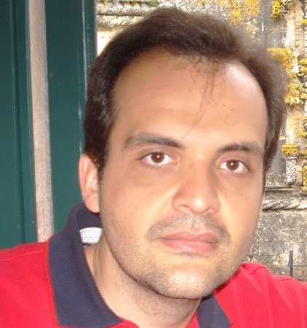
Deep Patient: Leveraging Electronic Health Records Data to Predict Patient Outcomes
By Tiago Vinhoza

Slide 14

Your 2 minute feedback
https://bit.ly/dspt27br
Notes:
TODO: criar form e gerar código

Slide 15
And the winner is
Notes:
https://script.google.com/macros/s/AKfycbxZYU-nD2rzoM4areo2p1LPMzhi7ZvOK6VtNV-n53WZr7MEq_pr/exec?id=13YuRsRG6ZY2uhDitZOzovJLbWBB5cFN9YkciIGgDJ3c

Slide 16
Thanks!
datascienceportugal.com
info@datascienceportugal.com
Notes:
And that’s it for today’s event! Now some of us will go have dinner together, and if you want to join, just feel free to stick around. Thank you.

